Slide 1
Venous and lymphatic drainage of Upper Limb
Dr Anita Rani
Professor, Department of Anatomy
20th October 2016

Slide 2
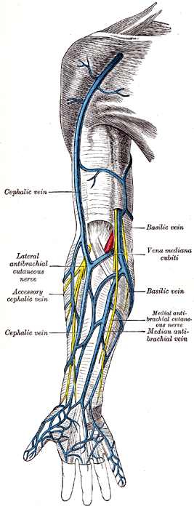
Superficial Veins
Preaxial : Cephalic vein
Post axial: Basilic vein
Run away from pressure points
Accompanied by cutaneous nerves and lymphatics NOT ARTERIES
Best utilized for IV injections

Slide 3
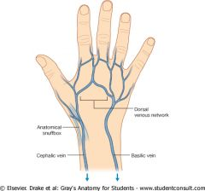
Dorsal Venous Arch/ Network
Lies on Dorsum of hand
Tributaries:
3 dorsal metacarpal veins
A Dorsal digital vein from medial side of little finger
A Dorsal digital vein from lateral side of index finger
2 dorsal digital veins from thumb
Most of the blood of palm
- perforating veins
- veins passing around margin of hand
Efferent:
cephalic and basilic veins

Slide 4
Cephalic vein: spends all of its time in subcutaneous tissues - drains the radial dorsum of hand
Preaxial vein (cf. great saphenous vein) longer vein
Begins from lateral end of dorsal venous arch
Runs upwards through roof of anatomical snuff box
Winds round the forearm
Reaches infront of elbow along lateral border of biceps brachii
Pierces deep fascia at lower border of pectoralis major
Runs in delto-pectoral groove
Pierces clavi-pectoral fascia to join axillary vein.

Slide 5
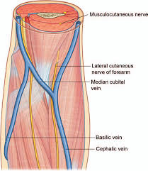
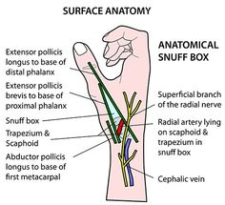
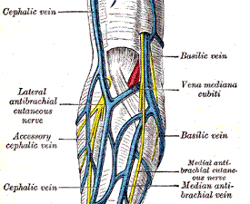
Cephalic vein
At elbow communicate to basilic vein through MEDIAN CUBITAL VEIN
Accompanied by lateral cutaneous nerve of forearm and terminal branch of radial nerve
An accessory cephalic vein may join it near elbow

Slide 6
Basilic Vein: drains the ulnar dorsum of the hand
Postaxial vein( cf. short saphenous vein of lower limb)
Smaller vein
Begins from medial end of dorsal venous arch
Runs upwards along back of medial border of forearm
Winds round at elbow and comes infront of medial epicondyle along medial margin of biceps brachii
At midarm pierces deep fascia
Runs along medial side of brachial artery upto lower border of teres major to continue as axillary vein

Slide 7
Basilic Vein
2.5 cm above medial epicondyle joined by MEDIAN CUBITAL VEIN .
Accompanied by medial cutaneous nerve of forearm and dorsal branch of ulnar nerve

Slide 8
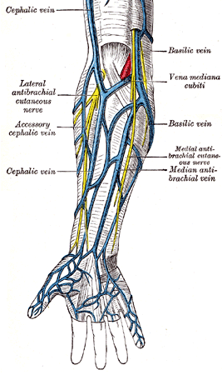
Median Cubital Vein
Large communicating vein which shunts blood from cephalic to basilic vein
Begins from cephalic
Vein 2.5 cm below the bend of elbow
Runs obliquely upwards and medially
Ends in basilic vein 2.5cm above the medial epicondyle

Slide 9
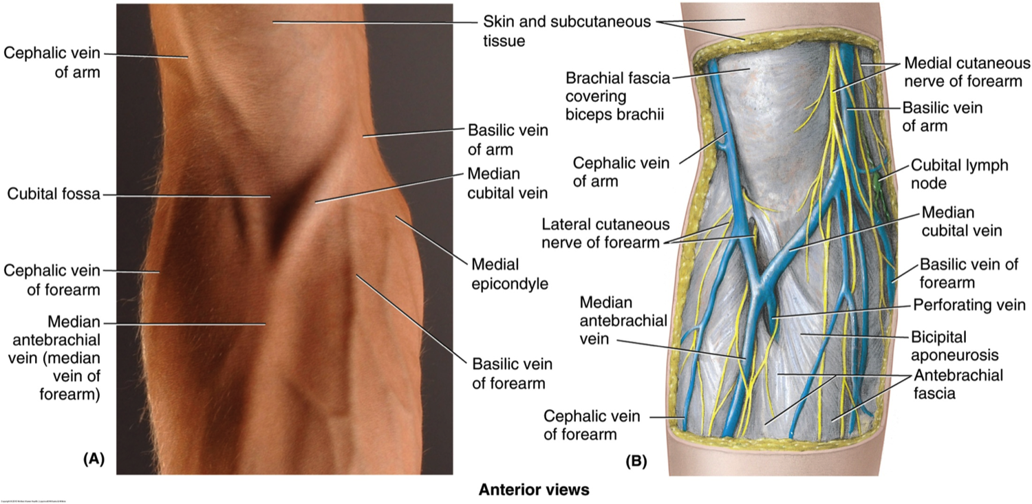
Median Cubital Vein
Seperated from brachial artery by bicipital aponeurosis
May receive median vein of forearm
Connected to deep veins through perforating vein, which pierces bicipital aponeurosis.
Perforator vein helps in fixing the median cubital vein: making it ideal for IV injections

Slide 10
Median Vein of Forearm
Begins from palmar venous network
Ends in any one of the veins of front of elbow

Slide 11
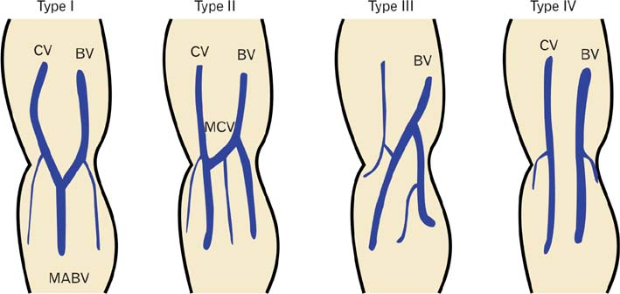
Variational Anatomy

Slide 12
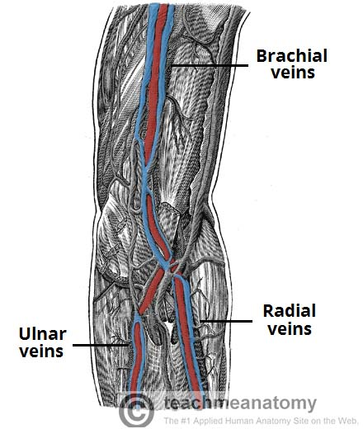
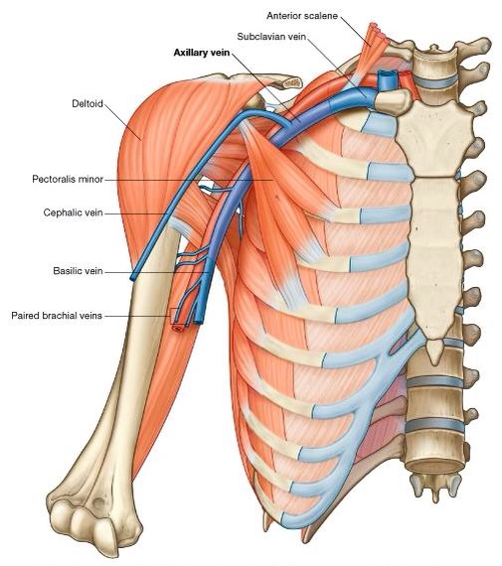
Deep Veins

Slide 13
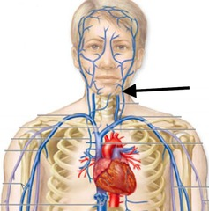
Applied Anatomy
Cephalic vein communicates with External Jugular Vein by a small vein, superficial to clavicle.
In operations of removal of breast in carcinoma cases, axillary vein is also cut.
This communication enlarges and helps in maintaining the circulation.
In cases of fracture of clavicle, rupture of this channel may lead to large hematoma.

Slide 14
Superficial Lymphatic Vessels
The superficial lymphatic vessels of the upper limb initially arise from lymphatic plexuses in the skin of the hand (networks of lymphatic capillaries beginning in the extracellular spaces).
They then ascend up the arm, in close proximity to the major superficial veins.

Slide 15
Superficial Lymphatic Vessels
The vessels shadowing the basilic vein go on to enter the cubital lymph nodes.
These lie medial to the vein, and proximally to the medial epicondyle of the humerus.
Vessels carrying on from these nodes then continue up the arm, terminating in the lateral axillary lymph nodes.

Slide 16
Superficial Lymphatic Vessels
The vessels shadowing the cephalic vein cross the proximal part of the arm and shoulder to enter the apical axillary lymph nodes, though some exceptions instead enter the more superficial deltopectoral lymph nodes.

Slide 17
Deep Lymphatic Vessels
Follow the major deep veins (i.e. radial, ulnar and brachial veins) to terminating in the humeral axillary lymph nodes.
They drain lymph from joint capsules, periosteum, tendons and muscles.
Some additional lymph nodes may be found along the ascending path of the deep vessels.

Slide 18
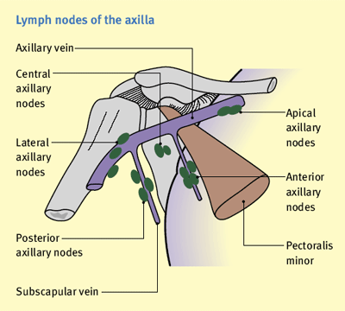
Lymph Nodes
The majority of the upper lymph nodes are located in the axilla.
Divided anatomically into 5 groups:
Pectoral (anterior)
Subscapular (posterior)
Humeral (lateral)
Central
Apical

Slide 19
Lymph Nodes
Pectoral (anterior) – 3-5 nodes, located in the medial wall of the axilla. They receive lymph primarily from the anterior thoracic wall, including most of the breast.

Slide 20
Lymph Nodes
Subscapular (posterior) – 6-7 nodes, located along the posterior axillary fold and subscapular blood vessels. They receive lymph from the posterior thoracic wall and scapular region.

Slide 21
Lymph Nodes
Humeral (lateral) – 4-6 nodes, located in the lateral wall of the axilla, posterior to the axillary vein. They receive the majority of lymph drained from the upper limb.

Slide 22
Lymph Nodes
Central
3-4 large nodes, located near the base of the axilla (deep to pectoralis minor, close to the 2nd part of the axillary artery). They receive lymph via efferent vessels from the pectoral, subscapular and humeral axillary lymph node groups.

Slide 23
Lymph Nodes
Apical –
Located in the apex of the axilla, close to the axillary vein and 1st part of the axillary artery.
They receive lymph from efferent vessels of the central axillary lymph nodes, therefore from all axillary lymph node groups.
The apical axillary nodes also receive lymph from those lymphatic vessels accompanying the cephalic vein.

Slide 24
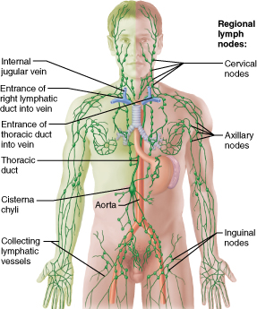
Efferent vessels from the apical axillary nodes travel through the cervico-axillary canal, before converging to form the subclavian lymphatic trunk.
The right subclavian trunk continues to form the right lymphatic duct, and enters the right venous angle (junction of internal jugular and subclavian veins) directly.
The left subclavian trunk drains directly into the thoracic duct.

Slide 25
Summarizing the drainage…..

Slide 26
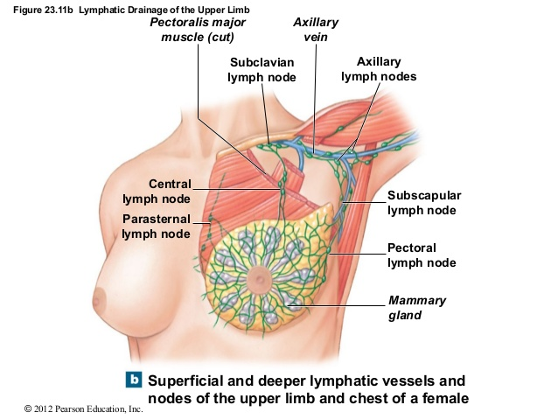
Lymphatic drainage of breast

Slide 27
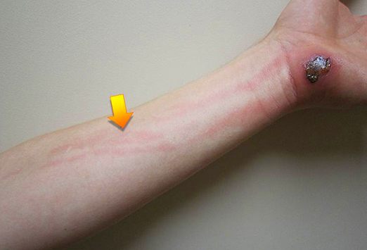
Applied Anatomy
Lymphangitis: inflammation of lymph vessel

Slide 28
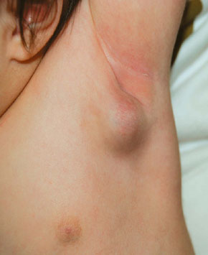
Applied Anatomy
Lymphadenitis: inflammation of lymph nodes

Slide 29
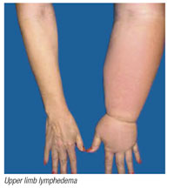
Applied Anatomy
Lymphoedema: obstruction to lymph vessels leading to edema

Slide 31
Which vein of upper limb is most commonly used for IV injections? A. Median Cubital Vein B. Cephalic vein C. Basilic vein D. Dorsal venous arch

Slide 32
Which of the following vein of upper limb is postaxial in location? A. Median Cubital Vein B. Cephalic vein C. Basilic vein D. Dorsal venous arch

Slide 33
Which of the following vein is most likely to bleed if a sharp cut occurs at anatomical snuff box? A. Median Cubital Vein B. Cephalic vein C. Basilic vein D. Dorsal venous arch

Slide 34
At which point basilic vein pierces deep fascia ? A. lower border of pectoralis major B. just below clavicle C. lower border of teres major D. middle of arm E. middle of forearm

Slide 35
Which of the following axillary lymph nodes primarily drain the upper limb? A. pectoral B. subscapular C. central D. lateral

Slide 36
Which of the following lymph node DOES NOT receive lymph from breast? A. pectoral B. subscapular C. humeral D. central

Slide 37
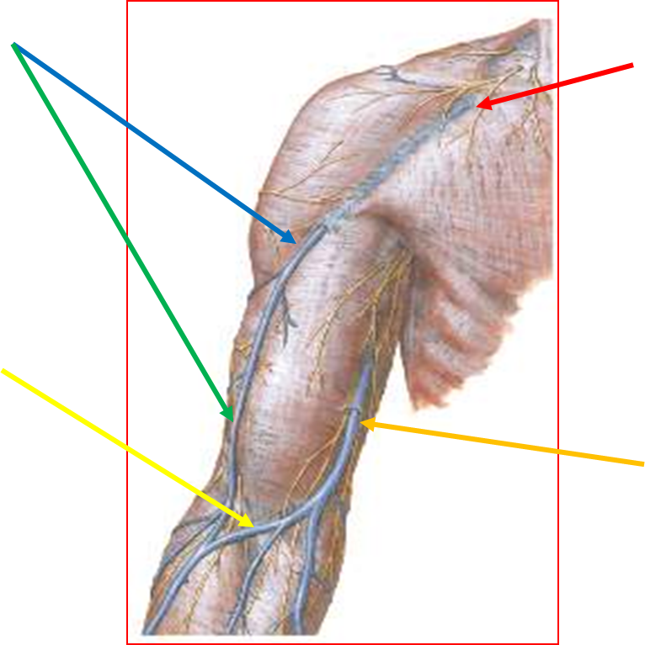

Slide 38
Please visit university website for downloading today’s presentation .
Give your feedback.
Thanks

